Slide 1
Object Oriented Programming
(SENG6022)
Arba Minch University
Institute of Technology
Faculty of Computing & Software Engineering
Mr. Addisu M. (Asst. Prof)
G2 SE - Regular

Slide 2
Exception Handling
Chapter Seven

Slide 3
Outline
01
Errors
02
Types of Exceptions
03
Error vs Exception
04
Throws vs Throw

Slide 4
Introduction
public class ArthemeticExceptionExample{
public static void main(String args[]){
int a=8;
int b=0;
int c=a/b;
System.out.println(c);
}
}
  What happens when this method is used to divide a number by zero?
    Program throws an Exception and fails
    Exception in thread "main" java.lang.ArithmeticException: / by zero

Slide 5
When Good Programs Go Bad?
  variety of errors can occur when a program is running.
  For example:
  (real) user input error - bad url
  device errors - remote server unavailable
  physical limitations - full disk
  code errors - interact with code that does not fulfill its contact (pre and post conditions)
  when an error occurs
  return to safe state, save work, exit gracefully
  error handling code may be far removed from code that caused the error

Slide 6
What is an Exception?
  When a problem encounters and unexpected termination or fault, it is called an exception
    An error event that disrupts the program flow and may cause a program to fail
  Some examples:
  Performing illegal arithmetic
  A user has entered invalid data
  Illegal arguments to methods
  Accessing an out-of-bounds array element
  Hardware failures
  Writing to a read-only file
  divide by 0

Slide 7
What is an Exception?
  What is Exception?
  Exception is an event that disrupts the normal flow of the program
  What is Exception handling?
  Exception Handling in Java is one of the powerful mechanism to handle the runtime errors so that normal flow of the application can be maintained such as ClassNotFoundException, IOException, SQLException, RemoteException etc
    When an exception happens we say it was thrown or raised
    When an exception is dealt with, we say the exception is handled or caught

Slide 8
Exception Handling
  What is the output of this program?
Example
public class ExceptionExample {
public static void main(String args[]) {
String[] greek = {"Alpha", "Beta"};
System.out.println(greek[2]);
}
}
Output:
Exception in thread "main"
java.lang.ArrayIndexOutOfBoundsException: 2 at ExceptionExample.main(ExceptionExample.java:4)

Slide 9
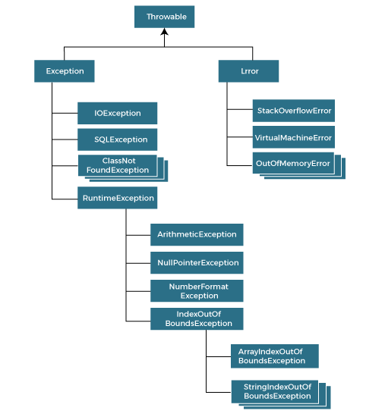
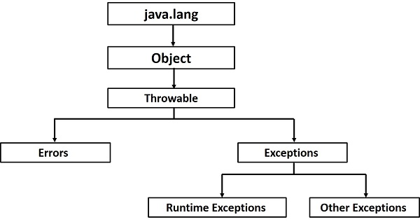
Hierarchy of Java Exception classes
  java.lang.Throwable class is the root class of Java Exception hierarchy inherited by two subclasses:
    Exception and
    Error

Slide 10
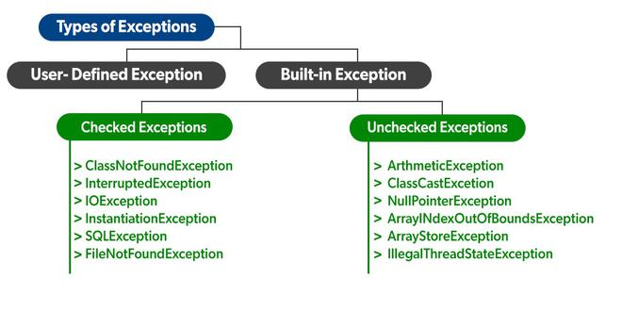
Types of Java Exceptions
  According to Oracle, three types of exceptions:
    Checked Exception
    Unchecked Exception
    Error

Slide 11
Difference between
Error
Exception
indicates a serious problem that a reasonable application should not try to catch
indicates conditions that a reasonable application might try to catch.

Slide 12
Difference between
Unchecked Exception
classes that inherit RuntimeException
Error
irrecoverable
Checked Exception
classes that directly inherit Throwable class except RuntimeException & Error
not checked at compile-time, but they are checked at runtime
checked at compile-time
E.g., OutOfMemoryError, VirtualMachineError, AssertionError etc.
E.g., IOException, FileNotFoundException, SocketException etc.
errors that programmer can directly prevent from occurring
errors that programmer cannot directly prevent from occurring
Usually occur because of programming errors, when code is not robust enough to prevent them
E.g., ArithmeticException, NullPointerException, ArrayIndexOutOfBoundsException, IllegalArgumentException, etc
are less frequent and cannot be ignored by the programmer . . .

Slide 13
Exceptions Methods
  list of methods available in the Throwable class
Function | Description
public String getMessage() | Returns a detailed message about the exception that has occurred. This message is initialized in the Throwable constructor.
public Throwable getCause() | Returns the cause of the exception as represented by a Throwable object.
public String toString() | Returns the name of the class concatenated with the result of getMessage().
public void printStackTrace() | Prints the result of toString() along with the stack trace to System.err, the error output stream.
public StackTraceElement [] getStackTrace() | Returns an array containing each element on the stack trace. The element at index 0 represents the top of the call stack, and the last element in the array represents the method at the bottom of the call stack.

Slide 14
How Does JVM handle an Exception?
  Default Exception Handling:
  if an exception has occurred, the method creates an Object known as an Exception Object and hands it off to the run-time system(JVM)
    exception object contains the name and description of the exception and current state of the program where the exception has occurred
  Creating the Exception Object and handling it in the run-time system is called throwing an Exception
  There might be a list of the methods that had been called to get to the method where an exception occurred
    This ordered list of the methods is called Call Stack

Slide 15
How Does JVM handle an Exception?
  Default Exception Handling:
  run-time system searches the call stack to find the method that contains a block of code that can handle the occurred exception
    block of the code is called an Exception handler
  If it finds an appropriate handler, then it passes the occurred exception to it
    appropriate handler – means type of the exception object thrown matches type of the exception object it can handle

Slide 16
How Does JVM handle an Exception?
  Default Exception Handling:
  If the run-time system searches all the methods on the call stack and couldn’t have found the appropriate handler, then the run-time system handover the Exception Object to the default exception handler, which is part of the run-time system
  This handler prints the exception information in the following format and terminates the program abnormally
Exception in thread "xxx" Name of Exception : Description
... ...... .. // Call Stack

Slide 17
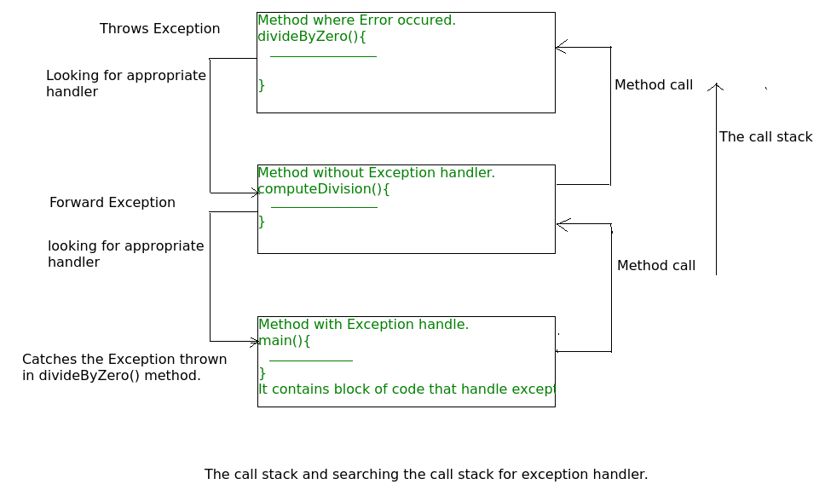
How Does JVM handle an Exception?
  flow of the call stack:

Slide 18
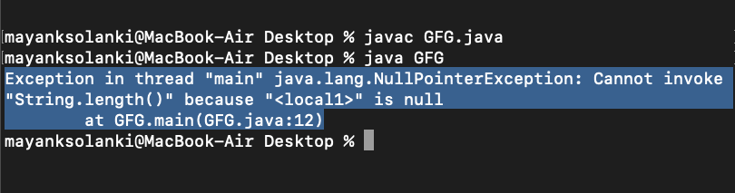
How Does JVM handle an Exception?
// Java Program to Demonstrate How Exception Is Thrown
class GFG {
public static void main(String args[]){
// Taking an empty string
String str = null;
// Getting length of a string
System.out.println(str.length());
}
}
Example
Output:

Slide 19
How Does JVM handle an Exception?
class GFG {
static int computeDivision(int a, int b){
int res = 0;
try {
res = a / b;
}
catch (NumberFormatException ex) {
System.out.println("NumberFormatException is occurred");
}
return res;
}
Example
public static void main(String args[]){
int a = 1, b = 0;
try {
int i = computeDivision(a, b);
}
catch (ArithmeticException ex) {
System.out.println(ex.getMessage());
}
}
}

Slide 20
How Programmer Handles an Exception?
  Customized Exception Handling:
  Java exception handling is managed via five keywords:
    try, catch, throw, throws, and finally
  Program statements that you think can raise exceptions are contained within a try block
  If an exception occurs within the try block, it is thrown
    Your code can catch this exception (using catch block) and handle it in some rational manner
    System-generated exceptions are automatically thrown by Java run-time system
  To manually throw an exception, use the keyword throw
  Any exception that is thrown out of a method must be specified as such by a throws clause
  Any code that absolutely must be executed after a try block completes is put in a finally block

Slide 21
How Programmer Handles an Exception?
  Java provides 5 keywords – used to handle exception
Keyword | Description
try | used to specify a block where we should place an exception code It means we can't use try block alone must be followed by either catch or finally
catch | used to handle the exception must be preceded by try block - means we can't use catch block alone can be followed by finally block later
finally | used to execute the necessary code of the program It is executed whether an exception is handled or not.
throw | used to throw an exception
throws | used to declare exceptions specifies that there may occur an exception in the method doesn't throw an exception always used with method signature

Slide 22
How Programmer Handles an Exception?
  Use try-catch block to handle exceptions that are thrown
    “try” keyword – used specify the a block where we should place exception code
    try block must be followed by either catch or finally.
    It means, we can’t use try block alone
        try {
        // code that might throw exception
        }
        catch ([Type of Exception] e) {
        // what to do if exception is thrown
        }

Slide 23
How Programmer Handles an Exception?
  “catch” block – used to handle the exception
    It must be preceded by try block which means we can’t use catch block alone.
    It can be followed by finally block later.
  “finally” block – used to execute important code of the program
    It is executed whether an exception is handled or not.

Slide 24
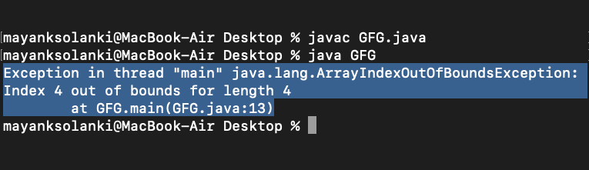
How Programmer Handles an Exception?
class GFG {
public static void main(String[] args)
{
int[] arr = new int[4];
int i = arr[4];
System.out.println("Hi, I want to execute");
}
}
Example
Output:

Slide 25
Common Scenarios of Java Exceptions
  1) ArithmeticException
  If we divide any number by zero, there occurs an ArithmeticException
  2) NullPointerException
  If we have a null value in any variable, performing any operation on the variable throws a NullPointerException
  3) NumberFormatException
  If the formatting of any variable or number is mismatched, it may result into NumberFormatException
  4) ArrayIndexOutOfBoundsException
  array exceeds to it's size, ArrayIndexOutOfBoundsException occurs
int a = 50/0;//ArithmeticException
String s=null;
System.out.println(s.length());//NullPointerException
String s="abc";
int i=Integer.parseInt(s);//NumberFormatException
int a[]=new int[5];
a[10]=50; //ArrayIndexOutOfBoundsException

Slide 26
throw vs throws
  throws - used to declare an exception, which means it works similar to the try-catch block. On the other hand, throw - used to throw an exception explicitly
  throw is followed by an instance of Exception class and throws is followed by exception class names
  throw - used in the method body to throw an exception, while throws - used in method signature to declare the exceptions that can occur in the statements present in the method

Slide 27
throw vs throws
Basis of Differences | throw | throws
Definition | used to explicitly throw an exception (checked or unchecked) from a method | used to declare exceptions
Type of exception | we can only propagate unchecked exception i.e., checked exception cannot be propagated using throw only | we can declare both checked and unchecked exceptions. However, the throws keyword can be used to propagate checked exceptions only
Syntax | followed by an instance of Exception to be thrown | followed by class names of Exceptions to be thrown
Declaration | used within the method | used with the method signature to indicate that this method might throw one of the listed type exceptions
Internal implementation | We are allowed to throw only one exception at a time i.e. we cannot throw multiple exceptions | We can declare multiple exceptions using throws keyword that can be thrown by the method. For example, main() throws IOException, SQLException

Slide 28
Java throw - Example
public class TestThrow {
public static void checkNum(int num) {
if (num < 1) {
throw new ArithmeticException("\nNumber is negative, cannot calculate square");
}
else {
System.out.println("Square of " + num + " is " + (num*num));
}
}
public static void main(String[] args) {
TestThrow obj = new TestThrow();
obj.checkNum(-3);
System.out.println("Rest of the code..");
}
}
Output:
Exception in thread "main" java.lang.ArthmeticException:
Number is negative, cannot calculate square
at TestThrow.checkNum(TestThrow.java:6)
at TestThrow.main(TestThrow.java:16)

Slide 29
Java throws - Example
public class TestThrows {
public static int divideNum(int m, int n) throws ArithmeticException {
int div = m / n;
return div;
}
public static void main(String[] args) {
TestThrows obj = new TestThrows();
try {
System.out.println(obj.divideNum(45, 0));
}
catch (ArithmeticException e){
System.out.println("\nNumber cannot be divided by 0");
}
System.out.println("Rest of the code..");
}
}
Output:
Number cannot be divided by 0
Rest of the code….

Slide 30
throw & throws - Example
public class TestThrowAndThrows {
static void method() throws ArithmeticException {
System.out.println("Inside the method()");
throw new ArithmeticException("throwing ArithmeticException");
}
public static void main(String args[]) {
try {
method();
}
catch(ArithmeticException e) {
System.out.println("caught in main() method");
}
}
}
Output:
Inside the method()
caught in main() method

Slide 31
THANKS!
Questions, Ambiguities, Doubts, … ???

